Slide 1



LegalEase (AI)
Legal-Pit-Stop for MSMEs
Personal Legal Professional for MSMEs

Slide 2


OUR TEAM
Vani Seth
201B299
Tanish Khandelwal
201B283

Slide 3

Prof. Mahesh Kumar
Under the Guidance:
P. No. MK5
Practical-1 Evaluation
Date: 03-11-2023

Slide 4
TABLE OF CONTENTS
01
02
03
04
05
OVERVIEW
Describes the foundation of chosen Project.
PROPOSED SOLUTION
Define Stakeholders and Viability of Project.
PROJECT GOALS
Outcomes of Proposed Solution & Requirements.
SYSTEM DESIGN
Structure of Project and Various Components.
PROJECT STAGES
Project Timeline with variable factors.

Slide 5

01
OVERVIEW
Describes the foundation of chosen Project.

Slide 6
PROBLEM STATEMENT
Populous country such as India handles and process tons of legal documents each day.
MSMEs plays a crucial role in Indian Economy and majority of them face issues while generating legal documents which are legal overhead for advocates, or HR dept.
Apart from generating documents, Understanding Documents, and Detecting irregularities within it, is also troublesome for various users.

Slide 7
SUPPORTING REFERENCES
LEGAL CHALLENGES FACED BY MSMEs
MSMEs: THE NEED FOR LEGAL SUPPORT
TOP 5 CHALLENGES FOR MSMEs FOR BUSINESS LOANS
LEGAL SUPPORT TO HELP MSMES TACKLE CHALLENGES

Slide 8
REQUIRED SYSTEM
Complex Legal Landscape: Simplify navigating India's intricate legal framework, ensuring compliance for MSMEs.
Access to Legal Expertise: Provide affordable legal guidance and document generation, bridging the knowledge gap.
Compliance Assurance: Offer a tool to help MSMEs meet regulatory requirements in line with Indian laws.
Time and Cost Efficiency: Streamline document management, reducing time and expenses for legal processes.
Empowering MSMEs: Enable small businesses to understand, create, and manage legal documents, fostering entrepreneurship.

Slide 9
02
PROPOSED SOLUTION
Define Stakeholders and Viability of Project.

Slide 10
WHAT ARE WE PROVIDING?
GENERATION
UNDERSTANDING
DETECTION
Updating or creating new documents.
Query any Legal document and get relevant answers.
Highlighting acceptable or unacceptable clauses.

Slide 11
MARKET LEADERs
KIRA
LUMINANCE
It automatically highlights and extracts provisions that are important to you and helps you organize your data for analysis.
Luminance uses next-generation AI to automate the generation, negotiation and analysis of contracts.

Slide 12
BUT THEY AREN’T TAILORED TO SERVE MSMEs

Slide 13
REQUIREMENTS
RESEARCH
MODEL
Scoping various factors required to build product.
Models for understanding data and finding !points.
DATA
PRODUCT
Data Quality plays important role.
Functional website providing 3 major features.

Slide 14
03
PROJECT GOALS
Outcomes of Proposed Solution & Requirements.

Slide 15
PROJECT GOALS
GOAL 1
Creating a utility which meets current demand.
GOAL 2
Design a solution accessible to all Stakeholders
GOAL 3
Launch the product for future Business Proposals.

Slide 16
STAKEHOLDERS
BUDDING FOUNDERS
GENERAL PUBLIC
CORPORATE
LAWYERS
HR DEPT

Slide 17
04
SYSTEM DESIGN
Structure of Project and Various Components.

Slide 18
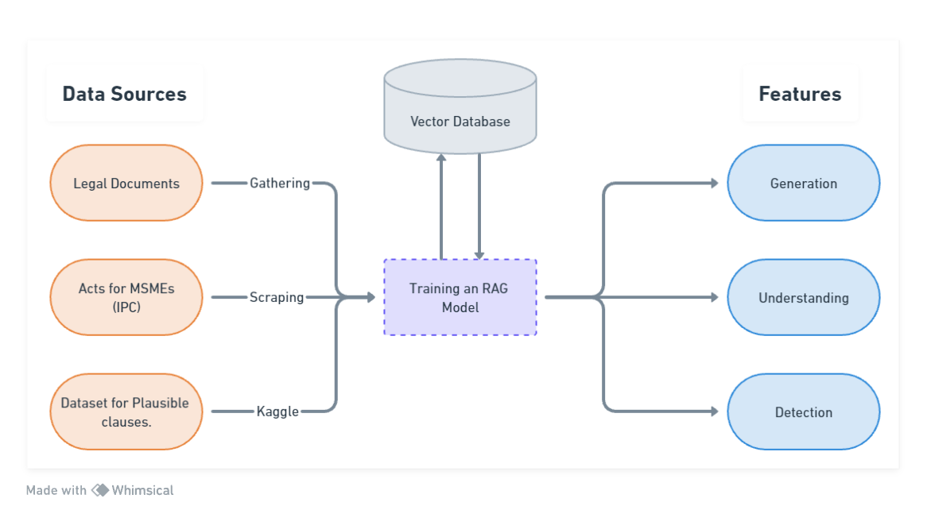

Slide 19
05
PROJECT STAGES
Project Timeline with variable factors.

Slide 20
PROJECT STAGES
Requirement Gathering and Project feasibility
P1
Document Understanding and Generation Features
P2
Completing Product with all features integrated
P3

Slide 21
THANKS!

